Slide 1

A comparison of 5 Countries around the World
Alberta “Albi” Kovatcheva

Slide 2
Background
The GapMinder website has a large collection of statistics about health and economic development for countries around the world. Its founder, Hans Rosling, has developed compelling ways to present statistical data. An R data set is available called Gapminder, and the I will use what I have learned about data manipulation and graphing to explore that dataset.

Slide 3
Scenario
I want to examine the quality of life in 5 countries in which I have been in.

Slide 4

A Comparison of 5 Countries
USA: My home.
Bulgaria: Where my parents came from.
Italy: Where I was conceived.
Denmark: Where I was born.
Venezuela: Where my parents immigrated before coming to the U.S.A.

Slide 5
Tasks
Which country of the five you chose has the lowest GDP Per Capita in 1952? In 2007?
Which has the highest GDP Per Capita in 1952? In 2007?
Create a line plot with year on the horizontal axis and lifeExp on the vertical axis for the five countries; give each country a different color line. Describe the variations in life expectancy between the countries.
Compute the median of lifeExp as a function of year for all the countries in the gapminder data frame. For what years is the life expectancy of each of the countries you selected above the median life expectancy for all countries?

Slide 6
A Comparison of GDP Per Capita
Part 1

Slide 7
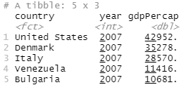
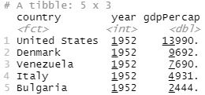
A Comparison of GDP Per Capita
Code to generate these two tibbles:
My5Revised <- gapminder %>%
filter(country %in% c("United States", "Bulgaria", "Venezuela", "Denmark", "Italy")) %>%
select(country, year, gdpPercap)
View(My5Revised)
filter(My5Revised, year == 1952) %>% arrange(desc(gdpPercap))
filter(My5Revised, year == 2007) %>% arrange(desc(gdpPercap))

Slide 8
Analysis
World median GDP Per Capita in 1952: 1969.
World median GDP Per Capita in 2007: 6124.
All 5 country's GDP Per Capita exceeds the world median in 1952 & 2007. median GDP in
1952 & 2007.

Slide 9
A Comparison of GDP Per Capita
 | Country | Year | GDP Per Capita
1 | United States | 1952 | 13990.482
 | United States | 2007 | 42951.65
2 | Denmark | 1952 | 9692.385
 | Denmark | 2007 | 35278.42
3 | Italy | 1952 | 7689.800
 | Italy | 2007 | 28569.72
4 | Venezuela | 1952 | 4931.404
 | Venezuela | 2007 | 11415.81
5 | Bulgaria | 1952 | 2444.287
 | Bulgaria | 2007 | 10680.79
In 1952 and 2007, respectively, Bulgaria has the lowest GDP Per Capita.

Slide 10
Analysis
 | Country | Year | GDP Per Capita
1 | United States | 1952 | 13990.482
 | United States | 2007 | 42951.65
2 | Denmark | 1952 | 9692.385
 | Denmark | 2007 | 35278.42
3 | Italy | 1952 | 7689.800
 | Italy | 2007 | 28569.72
4 | Venezuela | 1952 | 4931.404
 | Venezuela | 2007 | 11415.81
5 | Bulgaria | 1952 | 2444.287
 | Bulgaria | 2007 | 10680.79
Of these countries, only Bulgaria was communist.
Venezuela was and remains socialist, not communist.
Because the economies of Bulgaria and Venezuela have not been heavily profit-based, the countries also experienced a lower GDP per capita.

Slide 11
A Comparison of GDP Per Capita
 | Country | Year | GDP Per Capita
1 | United States | 1952 | 13990.482
 | United States | 2007 | 42951.65
2 | Denmark | 1952 | 9692.385
 | Denmark | 2007 | 35278.42
3 | Italy | 1952 | 7689.800
 | Italy | 2007 | 28569.72
4 | Venezuela | 1952 | 4931.404
 | Venezuela | 2007 | 11415.81
5 | Bulgaria | 1952 | 2444.287
 | Bulgaria | 2007 | 10680.79
1952 and 2007, respectively, the United States has the highest GDP Per Capita.

Slide 12
Analysis
 | Country | Year | GDP Per Capita
1 | United States | 1952 | 13990.482
 | United States | 2007 | 42951.65
2 | Denmark | 1952 | 9692.385
 | Denmark | 2007 | 35278.42
3 | Italy | 1952 | 7689.800
 | Italy | 2007 | 28569.72
4 | Venezuela | 1952 | 4931.404
 | Venezuela | 2007 | 11415.81
5 | Bulgaria | 1952 | 2444.287
 | Bulgaria | 2007 | 10680.79
During the 1950s, the United States experienced a significant increase in their GDP per capita.
This growth is attributed to a post-WW2 economic ‘boom’ and government spending: construction of interstate highways and schools, the distribution of veterans’ benefits, and increased military spending.

Slide 13
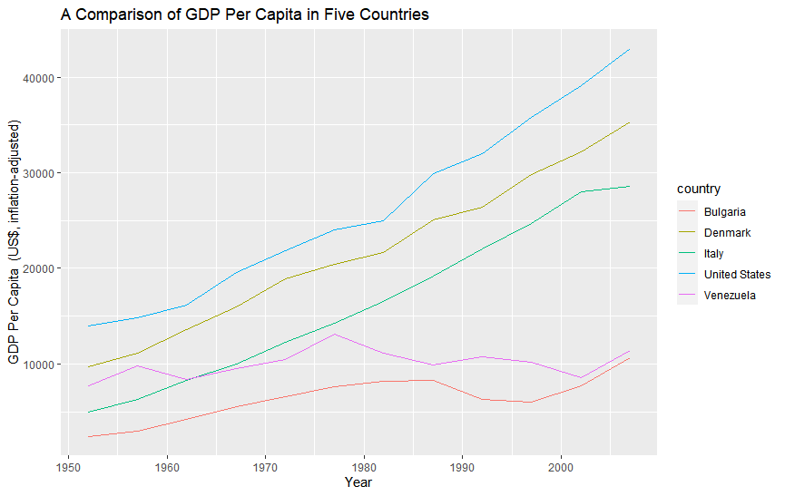
A Comparison of GDP Per Capita
Code to create this line plot:
ggplot(My5) + geom_line(aes(x = year, y = gdpPercap, color = country)) +
xlab("Year") + ylab("GDP Per Capita (US$, inflation-adjusted)") +
ggtitle("A Comparison of GDP Per Capita in Five Countries")

Slide 14
A Comparison of GDP Per Capita
During 1952 – 2007, the United States, Denmark, and Italy have experienced approximately linear growth in their GDP Per Capita. However, Italy’s growth slowed from 2002 – 2007.
On the other hand, Bulgaria and Venezuela both experienced limited and fluctuating economic growth. The declines in GDP per capita of both countries coincides with periods of political and economic unrest.

Slide 15
Analysis
Between 2001 – 2006, Italy experienced a significant change in political leadership. This can partly explain a slowing of Italy’s economic growth during this period.
On the other hand, Bulgaria experienced a decline in economic growth shortly before and after the fall of communism.
Venezuelan economic growth fluctuates based on the political leadership in the country.

Slide 16
A Comparison of Life Expectancies
Part 2

Slide 17
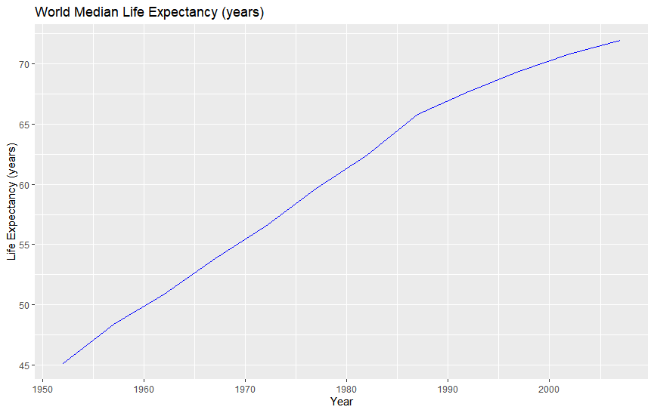
World Median Life Expectancy
Code to create this line plot:
ggplot(World) + geom_line(aes(x = year, y = life_med), color = "blue1") +
xlab("Year") + ylab("Life Expectancy (years)") +
ggtitle("World Median Life Expectancy (years)")

Slide 18

World Median Life Expectancy
 | Year | Median life Expectancy (years)
1 | 1952 | 45.1355
2 | 1957 | 48.3605
3 | 1962 | 50.8810
4 | 1967 | 53.8250
5 | 1972 | 56.5300
6 | 1977 | 59.6720
7 | 1982 | 62.4415
8 | 1987 | 65.8340
9 | 1992 | 67.7030
10 | 1997 | 69.3940
11 | 2002 | 70.8255
12 | 2007 | 71.9355
Over time, the world median life expectancy has been undergoing approximately logistic growth.

Slide 19
Analysis
Reasons for increased world median life expectancy:
Advances in healthcare
Advances in education
Advances in technology
Trade
Exchange of technological developments
Economic growth leading to improved access to resources

Slide 20
A Comparison of Life Expectancies
Year | World | USA | Bulgaria | Italy | Denmark | Venezuela
1952 | 45.1355 | 68.44 | 59.6 | 65.94 | 70.78 | 55.088
1957 | 48.3605 | 69.49 | 66.61 | 67.81 | 71.81 | 57.907
1962 | 50.881 | 70.21 | 69.51 | 69.24 | 72.35 | 60.77
1967 | 53.825 | 70.76 | 70.42 | 71.06 | 72.96 | 63.479
1972 | 56.53 | 71.34 | 70.9 | 72.19 | 73.47 | 65.712
1977 | 59.672 | 73.38 | 70.81 | 73.48 | 74.69 | 67.456
1982 | 62.4415 | 74.65 | 71.08 | 74.98 | 74.63 | 68.557
1987 | 65.834 | 75.02 | 71.34 | 76.42 | 74.8 | 70.19
1992 | 67.703 | 76.09 | 71.19 | 77.44 | 75.33 | 71.15
1997 | 69.394 | 76.81 | 70.32 | 78.82 | 76.11 | 72.146
2002 | 70.8255 | 77.31 | 72.14 | 80.24 | 77.18 | 72.766
2007 | 71.9355 | 78.242 | 73.005 | 80.546 | 78.332 | 73.747
For what years is the life expectancy of each of the countries you selected above the median life expectancy for all countries?
USA: 1952 – 2007
Bulgaria: 1952 – 2007
Italy: 1952 – 2007
Denmark: 1952 – 2007
Venezuela: 1952 – 2007

Slide 21
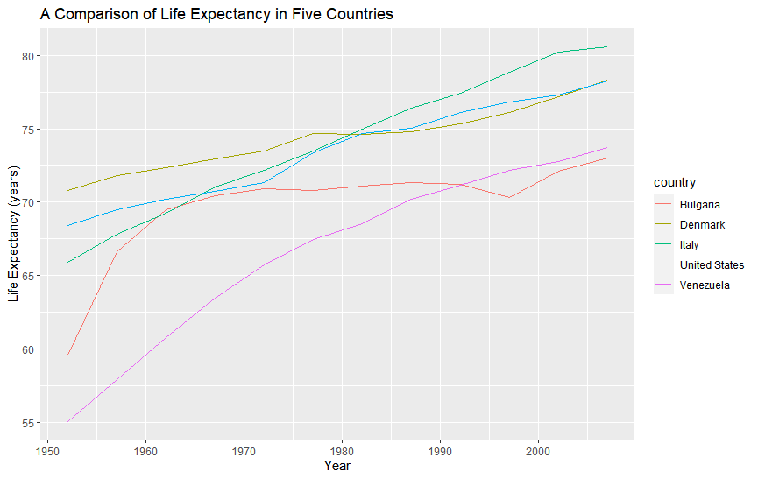
Analysis
Among these 5 countries, life expectancies have been increasing over time.
During 1952 – 2007, the life expectancies in the United States, Denmark, and Italy have been seeing an approximately linear increase. Between 1975 and 1985, Denmark experienced a minor decline in life expectancy .
During 1952 – 2007, Venezuela & Bulgaria have been experiencing approximately logistic growth in life expectancies. However, Bulgaria experienced a temporary and significant decline in life expectancy in the 1990s which coincided with the end of communism in the country.

Slide 22
Relationship between GDP Per Capita and Life Expectancy
Part 3

Slide 23
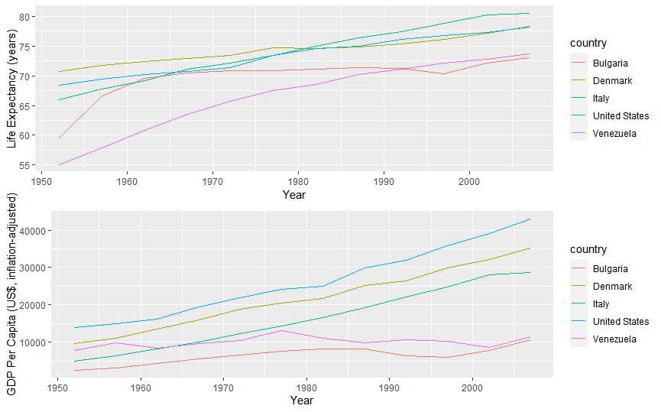
Relationship between GDP Per Capita & Life Expectancy
Code to create this line plot:
life_exp <- ggplot(My5) + geom_line(aes(x = year, y = lifeExp, color = country)) +
xlab("Year") + ylab("Life Expectancy (years)")
GDP <- ggplot(My5) + geom_line(aes(x = year, y = gdpPercap, color = country)) +
xlab("Year") + ylab("GDP Per Capita (US$, inflation-adjusted)")
grid.arrange(life_exp, GDP, ncol = 1)

Slide 24
Analysis
Of these 5 countries, both GDP per capita and life expectancy tend to increase over time.
This does not necessarily mean that growth in GDP per capita correlates with growth in life expectancy.
However, there is are strong reasons to believe that growth in GDP per capita can correlate with a growth in life expectancy.

Slide 25
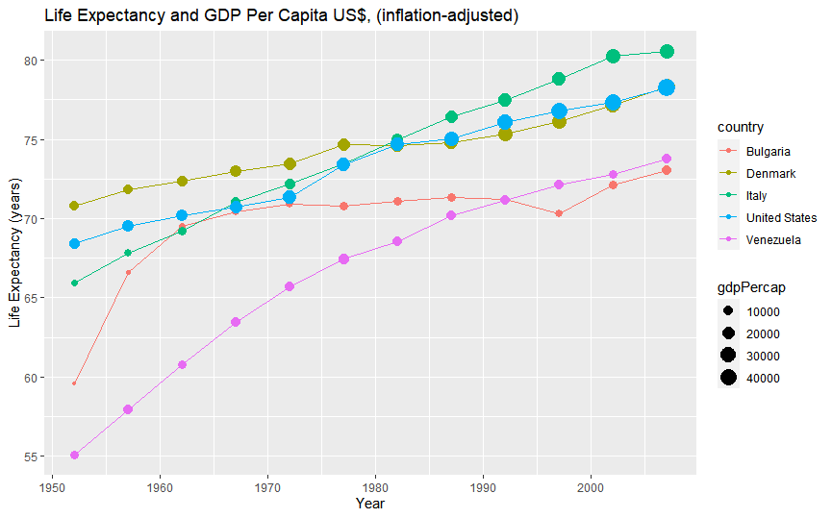
Relationship between GDP Per Capita and Life Expectancy
Code to create this line plot:
ggplot(My5, aes(x = year, y = lifeExp, color = country)) +
geom_line() + geom_point(aes(size = gdpPercap)) +
xlab("Year") +
ylab("Life Expectancy (years)") +
ggtitle("Life Expectancy and GDP Per Capita US$, (inflation-adjusted)")

Slide 26
Analysis
Countries with higher GDPs tend to have higher life expectancies. The reverse is also true- those with lower GDPs tend to have lover life expectancy.
After 1982, the life expectancy in Italy surpasses that of the U.S.A. This could be due to lifestyle rather than improved economic circumstances. For example, people in Italy tend to walk a lot more and shop only for the 1-3 days ahead.

Slide 27
Analysis
Despite having a higher GDP per capita than Bulgaria, Venezuela has a generally experienced a lower life expectancy until 1992.
In 1992, Venezuela’s median life expectancy surpassed that of Bulgaria. In 1986, the Chernobyl disaster occurred, and the contamination spread to across Europe, including Bulgaria.
Throughout the 1990’s Bulgaria experienced radiation contamination due to its own nuclear power plant, the Kozloduy. This is considered one of the most dangerous nuclear power plants in the world, and the units with the greatest leakage have been decommissioned.

Slide 28
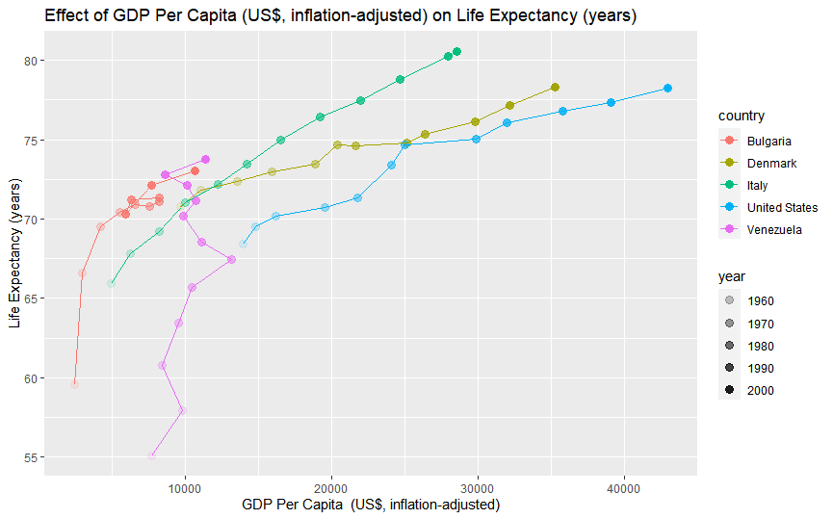
Effect of GDP Per Capita on Life Expectancy
Code to create this point plot:
ggplot(My5, aes(x = gdpPercap, y = lifeExp, color = country)) +
geom_point(aes(alpha = year), size = 3) + geom_path() +
xlab("GDP Per Capita (US$, inflation-adjusted)") +
ylab("Life Expectancy (years)") +
ggtitle("Effect of GDP Per Capita (US$, inflation-adjusted) on Life Expectancy (years)")
scale_alpha(range = c(0.3, 1.0))

Slide 29
Analysis
As GDP per capita increases, life expectancy also increases. Conversely, if GDP per capita decrease, life expectancy also tends to decrease.
When GDP per capita increases, people’s standard of living improves with greater access to:
Healthcare
Education
Professional development
Technology
Improved public infrastructure
All the above factors in turn further help the economy due to feedback.

Slide 30
Relationship between GDP Per Capita and Life Expectancy
Part 3

Slide 31
Conclusion
As GDP per capita increases, life expectancy also increases. Conversely, if GDP per capita decrease, life expectancy also tends to decrease.
When GDP per capita increases, people’s standard of living improves.
During 1952 – 2007, all 5 countries have higher median life expectancies than that of the world median life expectancies. Declines in life expectancy coincide with social, political, and economic unrest.
In 1952 & 2007, all 5 countries have a higher GDP per capita than the world’s median. Declines in GDP per capita coincide with social, political, and economic unrest.
Given the trajectory of the world median life expectancy, the world’s standard of living is improving, and more people are gaining access to the resources that they need in order to live well.

